Slide 1
5th Grade Science Camp
Sky Ranch- Van, TX

Slide 2
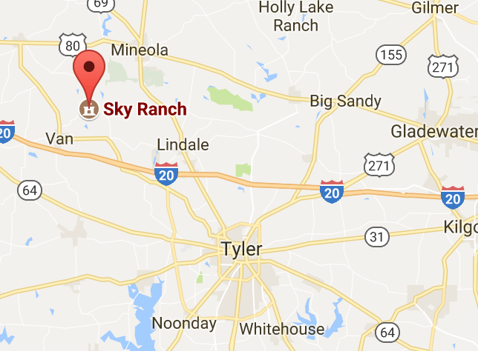
Nuts and Bolts
Purpose:
To provide 5th grade students with an off campus camp experience with an emphasis on Science TEKS.
Location:
24657 County Rd. 448
Van, TX 75790
Trip Dates:
November 1st through November 3rd

Slide 3
Departure & Arrival
Departure to Sky Ranch- Nov. 1st
Arrival back to Folsom- Nov. 3rd
8:30 AM Buses load at Folsom
8:45 AM Buses depart to Sky Ranch
11:15 AM Approximate arrival to Sky Ranch
11:45 AM Buses arrive at Sky Ranch
12:00 PM Buses depart to Folsom
2:30 PM Approximate arrival back to Folsom
Transportation provided by PISD school buses

Slide 4
Pick up on November 3rd
Students should be picked up by a parent or approved Emergency Contact by 3:00 PM
Students may go to Alphabest. Alphabest will provide a staging for luggage.

Slide 5
Luggage
Each child can bring TWO duffle bags/luggage. One duffle bag for their clothes, toiletries, shoes, etc. The other duffle bag for their sleeping bag, blanket, pillow, sheets, and towels.
Luggage tags will be provided by the campus with your child’s first and last name. The tags will be color coded to coordinate with their cabin assignment.
Please make sure there is additional identification on your child’s luggage in the event the school luggage tag is damaged/lost

Slide 6
Technology
Technology will NOT be allowed at Sky Ranch
No, this is not a ploy to gain more chaperones!
The main reason is liability, but we also want our students to have a true camp experience.
A closed Twitter group will be created to share updates and pictures.
A Remind-101 account will also be set up for messages to parents such as arrival and departure You will also be able to send any messages you need to get to your student.

Slide 7
Payment for Camp
You will send in all payments to your homeroom teacher. You can send in cash or check (made payable to Folsom Elementary).
ALL payments are due no later than October 18.
Cost per child is $188 and cost per chaperone is $182.

Slide 8
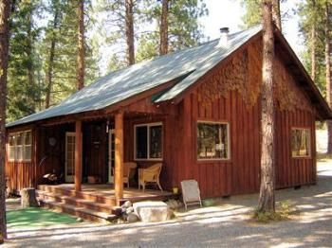
Accommodations

Slide 9
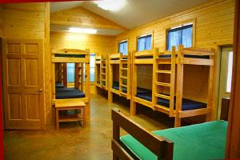
Rooms
Students and chaperones stay in cabins.
Air & Heat
Indoor bathrooms
Private showers

Slide 10
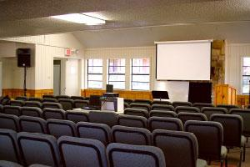
Classrooms
There are 14 different classrooms throughout the camp and they will have them ready for us when we get there.

Slide 11
Daily Schedule
Rise and Shine 7:00 AM
Breakfast
Classes
Lunch
Classes
Dinner
Evening Activities
Lights Out 10:00 PM

Slide 12
Daytime Classes
*Limnology (Aquatic Study):
Become “immersed” in Limnology, the study of freshwater. Spend time in our Limnology Center investigating water quality, the water web, life cycles, learned and inherited traits. Observe aquatic animals in our aquariums and hold a live turtle from out touch tank. Conduct water quality measurements using genuine scientific equipment. Make field collections of aquatic plans and animals at Sky Lake.
*Challenges:
Learn the value of good communication, trust, and cooperation in an atmosphere fostering creativity, problem solving, and experiential learning. Be a part of a team to solve problems and accomplish goals. Put critical thinking skills into action.
*Forces in Nature:
Explore the Forces in Nature which shape our Environment. Learn about gravity and friction while using our four story zip line. Discover gases and pressure during the building and launching of air rockets. Take a one hour nature hike and observe the real life effects of weathering agents, erosion, and deposition on the landscape.
*Orienteering:
Try to find the way to the hidden base camp. Learn the different parts of the compass, basic compass skills, and the difference between Magnetic North and True North. Venture out in teams and practice orienteering skills. Step into the future of orienteering by learning Geometrics, which combines Orienteering with new age technology of GPS mapping. Calculate tree heights and diameters, identify tree species, and build a map using handheld GPS units.

Slide 13
Evening Activities
*Campfire:
As smoke swirls and flames dance, enjoy stories, songs and side-splitting skits that will make you laugh and create magical memories of your Sky Ranch Experience.
*Clue:
Mysterious happenings at Sky Ranch! A crime has been committed! Do you have a “clue” about what’s going on? Use your teamwork and problem solving skills to dig up the facts and try to unravel this fun-filled Sky Ranch mystery

Slide 14
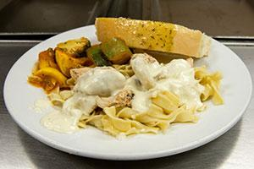
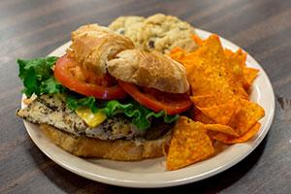
Food
Carefully planned, well-balanced menu
Salad Bar and fresh fruits at each meal
Vegetarian or gluten free diets can be accommodated…please let us know if your child needs this accommodation.

Slide 15
Medical Concerns/Medicines
Please make sure to fill out all three medical forms thoroughly so that we have up to date information. If any information changes after you turn in the paperwork, please be sure to contact the Nurse to inform her of the changes.
Please be sure to send in or bring in any medicines that your child will need (or could possibly need) at camp NO LATER THAN MONDAY, October 23.
Note: If your child might need Tylenol or Advil…you must send it in and fill it out on the medical form as our Nurse can only give medicine that you have told her about.

Slide 16
Chaperones
Please fill out the chaperone form if you are interested in possibly being a chaperone.
All chaperone interest forms are due to homeroom teachers by September 18.
You will find out if you have been selected to be a chaperone by Tuesday, September 26.
If you are chosen to be a chaperone, there will be MANDATORY informational chaperone meeting Date and Time TBD (Week of October 9)
Your Chaperone payment will be due no later than October 18.

Slide 17
More to come!
Permission slips and chaperone request forms will go home September 7th
Permission slips and money due by October 18th
“What to Pack” list goes home with Permission slip and again prior to trip

